Slide 1
Parallel Algorithms for Geometric Graph Problems
Grigory Yaroslavtsev
http://grigory.us
To appear in STOC 2014, joint work with Alexandr Andoni, Krzysztof Onak and Aleksandar Nikolov.

Slide 2


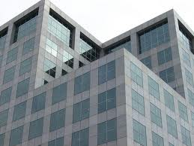
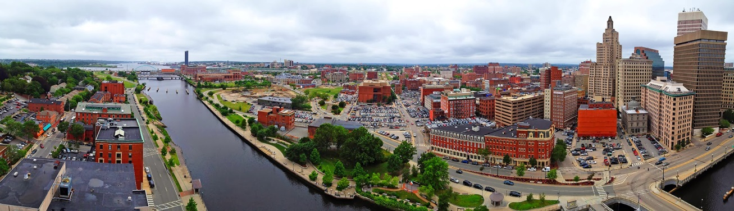
Postdoctoral Fellow
icerm.brown.edu
By Mike Cohea
Spring 2014: “Network Science and Graph Algorithms”
Fall 2014: “High-dimensional approximation”

Slide 3
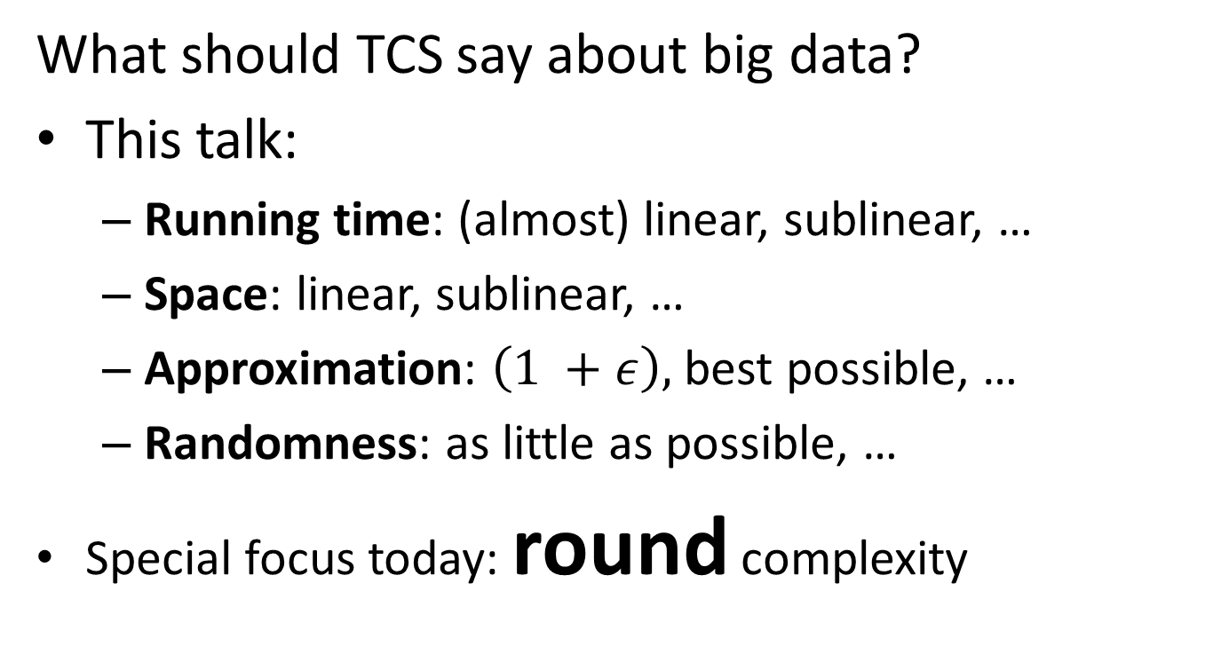
“The Big Data Theory”
What should TCS say about big data?
This talk:
  Running time: (almost) linear, sublinear, …
  Space: linear, sublinear, …
  Approximation: $\left(1 +ε\right),$ best possible, …
  Randomness: as little as possible, …
  Special focus today: round complexity

Slide 4
Round Complexity
Information-theoretic measure of performance
Tools from information theory (Shannon’48)
Unconditional results (lower bounds)
Example:
Approximating Geometric Graph Problems

Slide 5
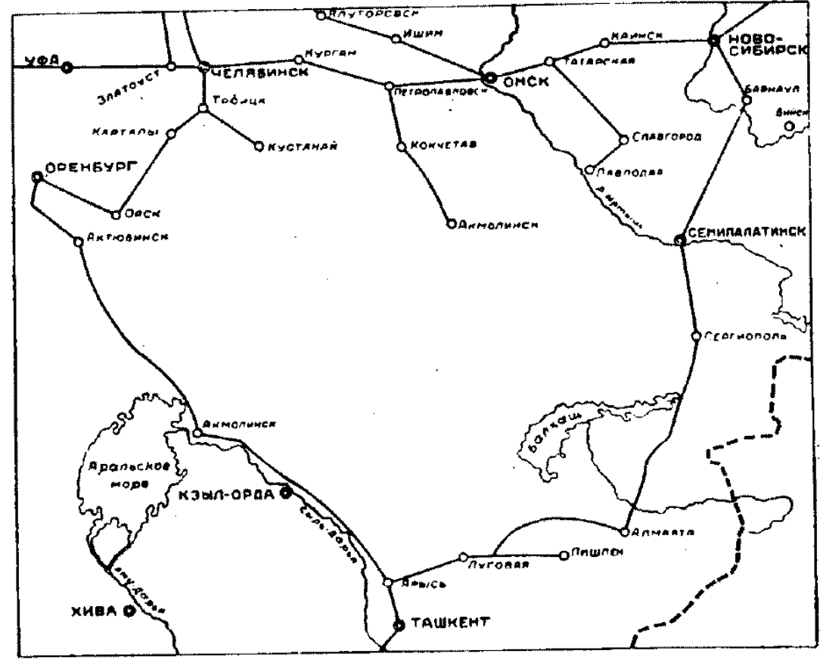
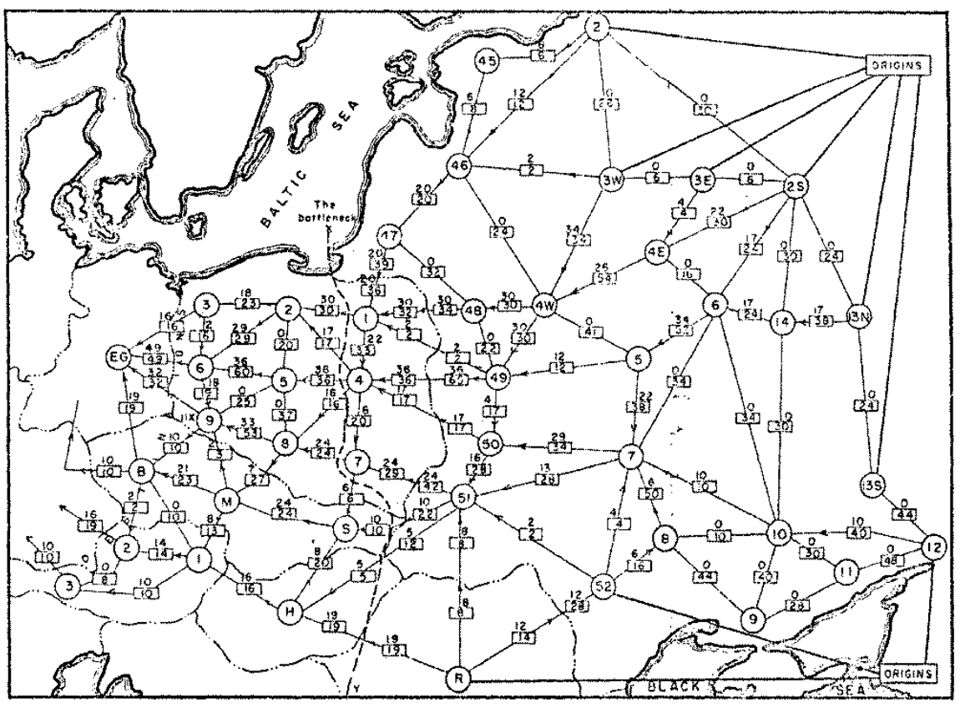
Approximation in Graphs
1930-50s: Given a graph and an optimization problem…
Transportation Problem:
Tolstoi [1930]
Minimum Cut (RAND):
Harris and Ross [1955] (declassified, 1999)
Notes:
The field of combinatorial optimization and approximation on graphs started back in the 1930-50s.
Tolstoi first considered the so-called transportation problem between supplies and demands.
A complementary problem of finding a minimum cut was considered by RAND.
As the declassified report

Slide 6

Approximation in Graphs
1960s: Single processor, main memory (IBM 360)

Slide 7
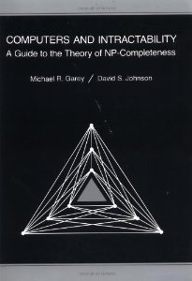
Approximation in Graphs
1970s: NP-complete problem – hard to solve exactly in time polynomial in the input size
“Black Book”

Slide 8
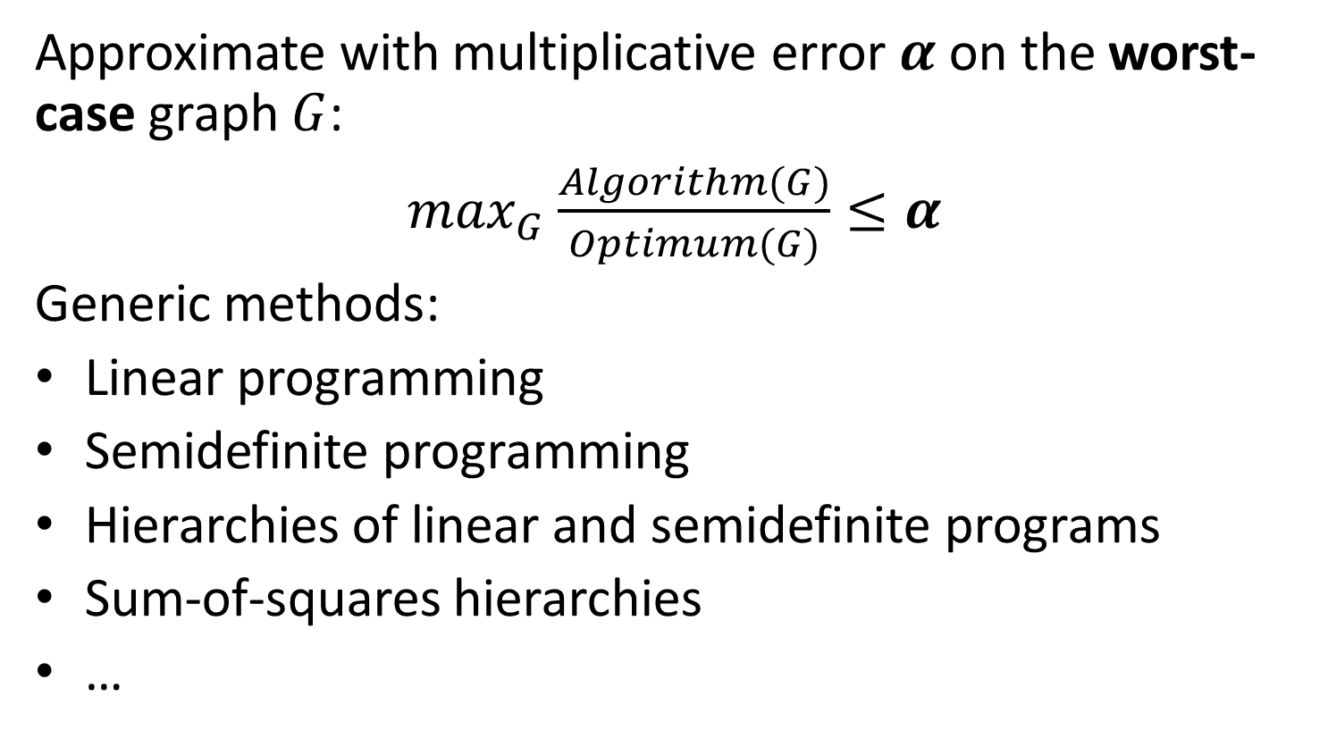
Approximation in Graphs
Approximate with multiplicative error $α$ on the worst-case graph $G$:
$\max_{G}$ $\frac{Algorithm(G)}{Optimum(G)}≤α$
Generic methods:
Linear programming
Semidefinite programming
Hierarchies of linear and semidefinite programs
Sum-of-squares hierarchies
…
Notes:
Give examples of specific problems and recent breakthroughs

Slide 9

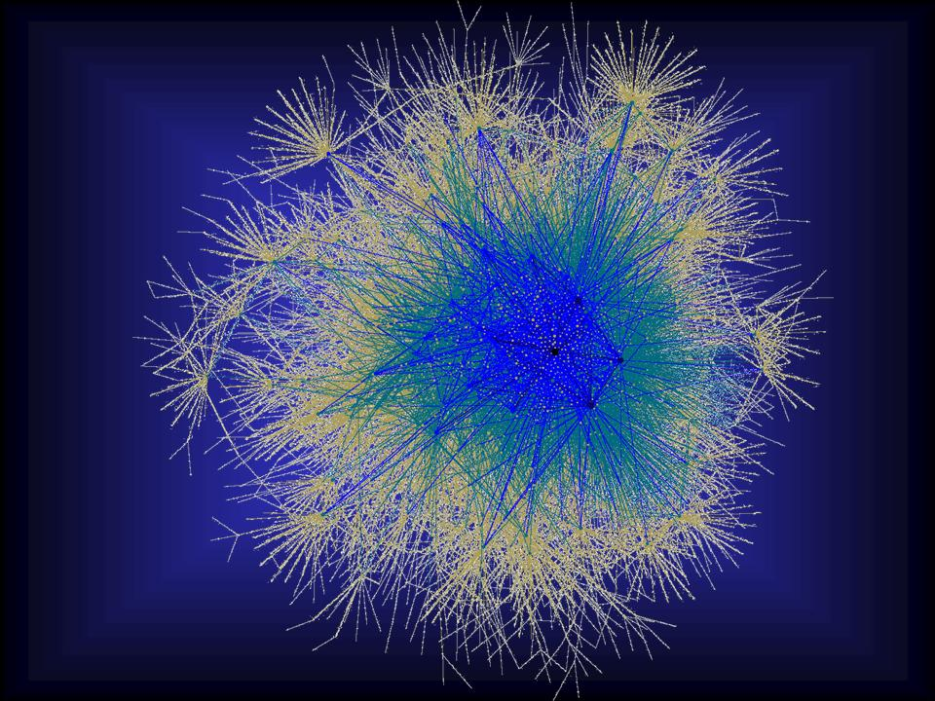

The New: Approximating Geometric Problems in Parallel Models
1930-70s to 2014

Slide 10
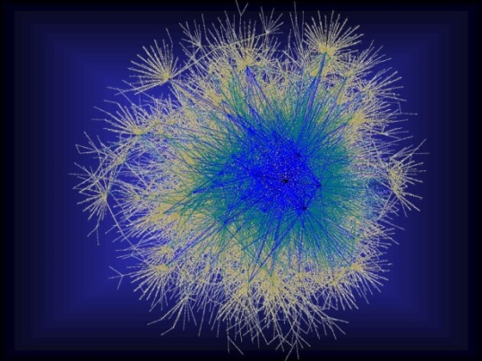
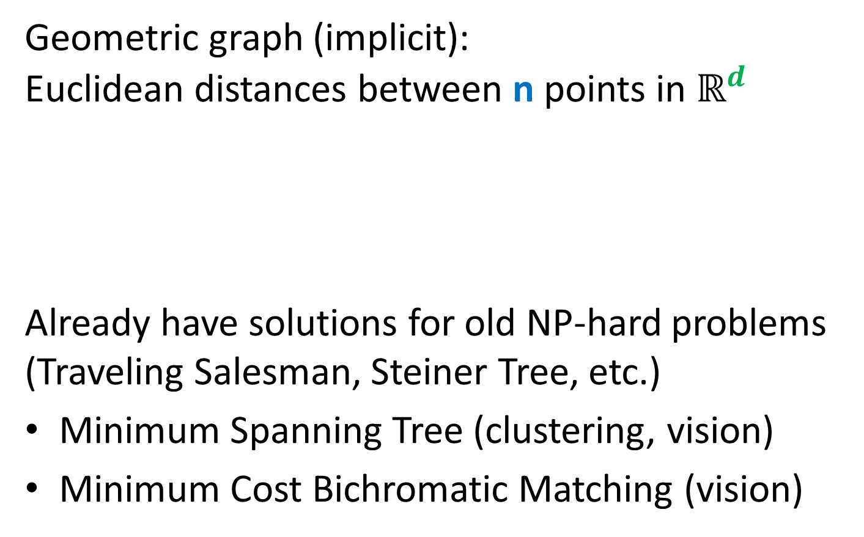
The New: Approximating Geometric Problems in Parallel Models
Geometric graph (implicit): Euclidean distances between n points in $ℝ^{d}$
Already have solutions for old NP-hard problems (Traveling Salesman, Steiner Tree, etc.)
Minimum Spanning Tree (clustering, vision)
Minimum Cost Bichromatic Matching (vision)
Notes:
Question: do we really have an O(1)-round algorithm for TSP and Steiner Tree?

Slide 11




Geometric Graph Problems
Combinatorial problems on graphs in $ℝ^{d}$
Polynomial time (easy)
Minimum Spanning Tree
Earth-Mover Distance =
Min Weight Bi-chromatic Matching
NP-hard (hard)
Steiner Tree
Traveling Salesman
Clustering (k-medians, facility location, etc.)
Need new theory!
Arora-Mitchell-style “Divide and Conquer”, easy to implement in Massively Parallel Computational Models

Slide 12
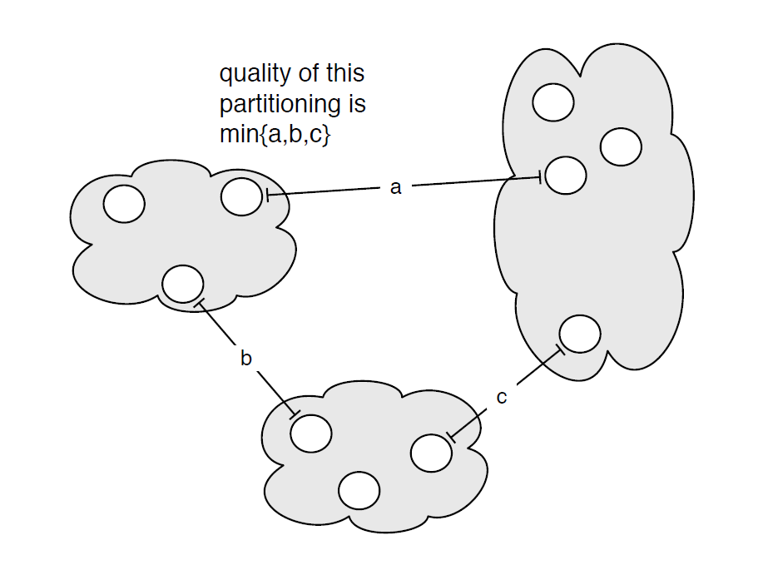

MST: Single Linkage Clustering
[Zahn’71] Clustering via MST (Single-linkage):
k clusters: remove $k−1$ longest edges from MST
Maximizes minimum intercluster distance
[Kleinberg, Tardos]
Notes:
“”

Slide 13
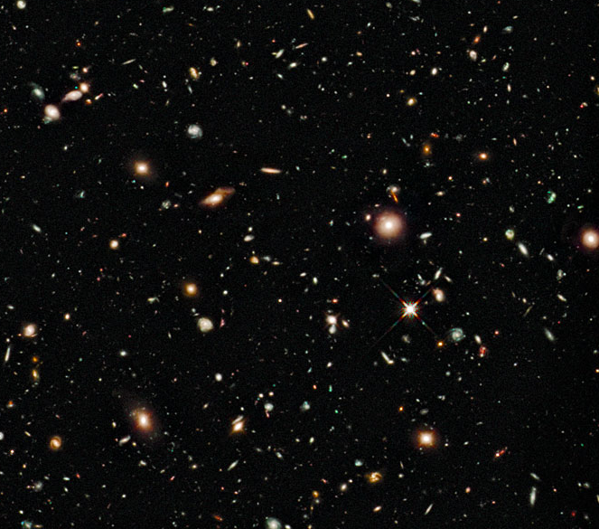
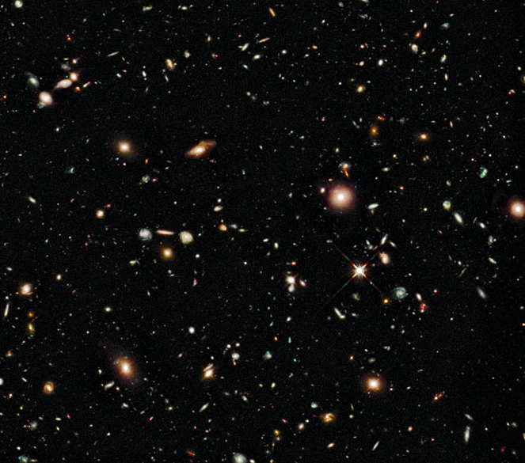
Earth-Mover Distance
Computer vision: compare two pictures of moving objects (stars, MRI scans)

Slide 14

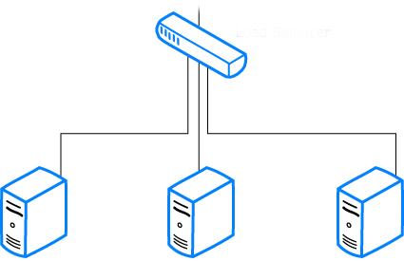

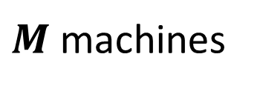
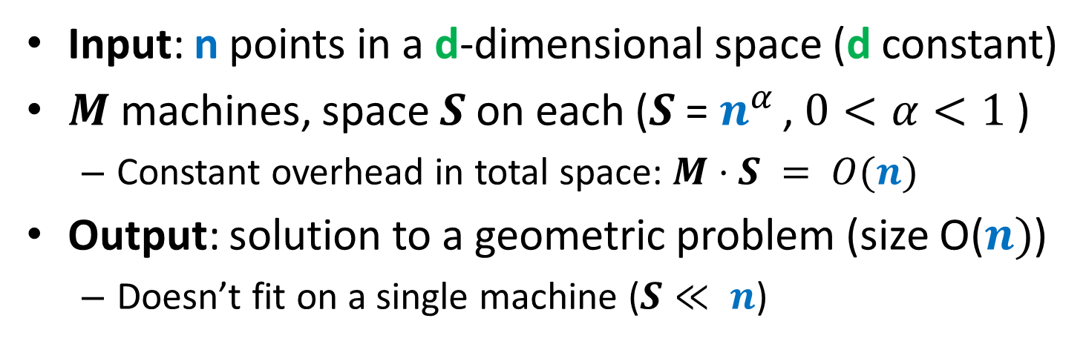

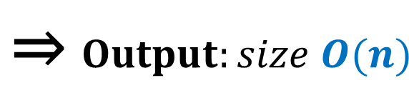

Computational Model
Input: n points in a d-dimensional space (d constant)
$M$ machines, space $S$ on each ($S$ = $n^{α }$, $0<α<1$ )
  Constant overhead in total space: $M⋅S = O(n)$
Output: solution to a geometric problem (size O($n)$)
  Doesn’t fit on a single machine ($S≪ n$)
$Input: n$ points ⇒
$$\text{⇒} Output:size O(n)$$
$M$machines
S space

Slide 15



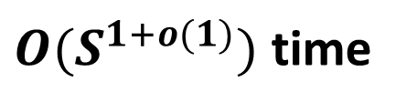
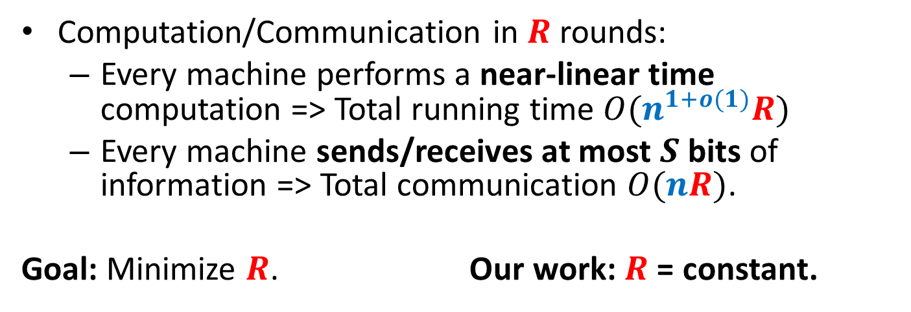
Computational Model
Computation/Communication in $R$ rounds:
  Every machine performs a near-linear time computation => Total running time $O(n^{1+o(1)}R)$
  Every machine sends/receives at most $S$ bits of information => Total communication $O(nR)$.
  Goal: Minimize $R$. Our work: $R$ = constant.
$≤S$ bits
$M$machines
S space
$O(S^{1+o(1)})$ time

Slide 16

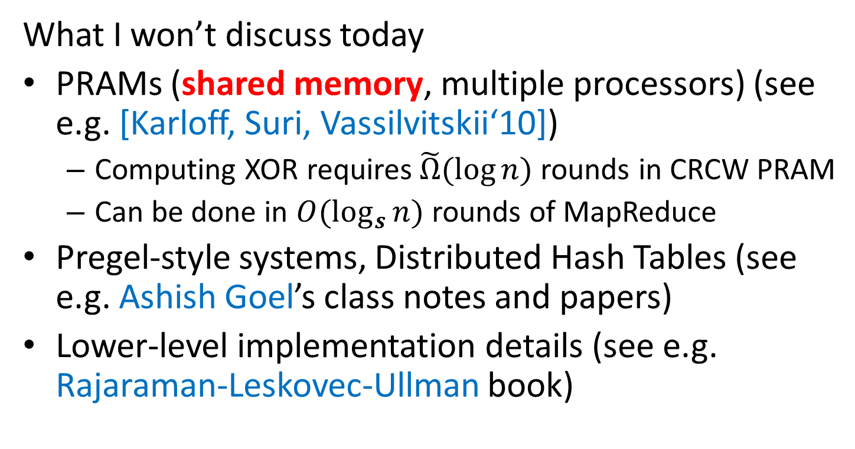
MapReduce-style computations
What I won’t discuss today
PRAMs (shared memory, multiple processors) (see e.g. [Karloff, Suri, Vassilvitskii‘10])
  Computing XOR requires$\tilde{Ω}(\log{n})$ rounds in CRCW PRAM
  Can be done in $O(\log_{s}{n})$ rounds of MapReduce
Pregel-style systems, Distributed Hash Tables (see e.g. Ashish Goel’s class notes and papers)
Lower-level implementation details (see e.g. Rajaraman-Leskovec-Ullman book)

Slide 17
Models of parallel computation
  Bulk-Synchronous Parallel Model (BSP) [Valiant,90]
    Pro: Most general, generalizes all other models
    Con: Many parameters, hard to design algorithms
  Massive Parallel Computation [Feldman-Muthukrishnan-Sidiropoulos-Stein-Svitkina’07, Karloff-Suri-Vassilvitskii’10, Goodrich-Sitchinava-Zhang’11, ..., Beame, Koutris, Suciu’13]
    Pros:
    Inspired by modern systems (Hadoop, MapReduce, Dryad, Pregel, … )
    Few parameters, simple to design algorithms
    New algorithmic ideas, robust to the exact model specification
    # Rounds is an information-theoretic measure => can prove unconditional lower bounds
    Between linear sketching and streaming with sorting

Slide 18
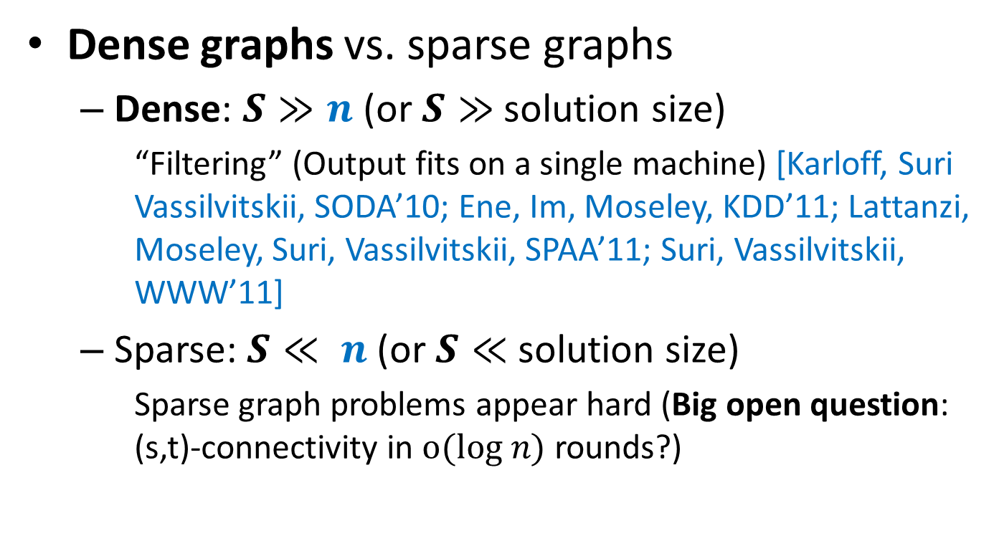
Previous work
Dense graphs vs. sparse graphs
  Dense: $S≫n$ (or $S≫$ solution size)
    “Filtering” (Output fits on a single machine) [Karloff, Suri Vassilvitskii, SODA’10; Ene, Im, Moseley, KDD’11; Lattanzi, Moseley, Suri, Vassilvitskii, SPAA’11; Suri, Vassilvitskii, WWW’11]
  Sparse: $S≪ n$(or $S≪$ solution size)
    Sparse graph problems appear hard (Big open question: (s,t)-connectivity in $o(log n)$ rounds?)
VS.

Slide 19

Large geometric graphs
Graph algorithms: Dense graphs vs. sparse graphs
  Dense: $S≫n$.
  Sparse: $S≪ n$.
Our setting:
  Dense graphs, sparsely represented: O(n) space
  Output doesn’t fit on one machine ($S≪ n$)
Today: $(1+ε)$-approximate MST
  $d=2$ (easy to generalize)
  $R=\log_{S}{n}\text{= }\text{O}\text{(1) }$rounds ($S=n^{Ω(1)}$)

Slide 20
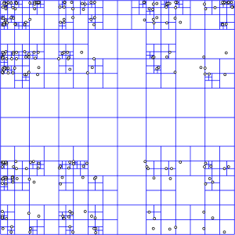
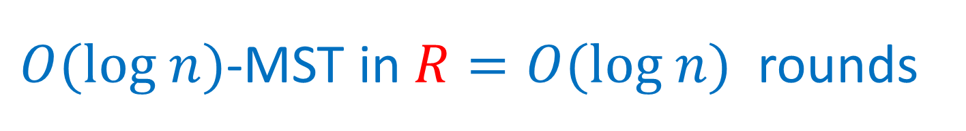

$O(log n)$-MST in $R=O(log n)$rounds
Assume points have integer coordinates $\left[0, …,Δ\right]$, where $Δ=O\left(n^{2}\right) .$
Impose an $O(log⁡n)$-depth quadtree
Bottom-up: For each cell in the quadtree
  compute optimum MSTs in subcells
  Use only one representative from each cell on the next level
Wrong representative:
O(1)-approximation per level

Slide 21





$εL$-nets
$εL$-net for a cell C with side length $L$:
  Collection S of vertices in C, every vertex is at distance <= $εL$ from some vertex in S. (Fact: Can efficiently compute $ε$-net of size $O\left(\frac{1}{ε^{2}}\right))$
Bottom-up: For each cell in the quadtree
  Compute optimum MSTs in subcells
  Use $εL$-net from each cell on the next level
Idea: Pay only $O(εL$) for an edge cut by cell with side $L$
Randomly shift the quadtree: $\operatorname{Pr}\left[cut edge of length ℓ by L\right]∼ℓ/L$ – charge errors
Wrong representative:
O(1)-approximation per level
$$L$$
$$εL$$
$$L$$

Slide 22



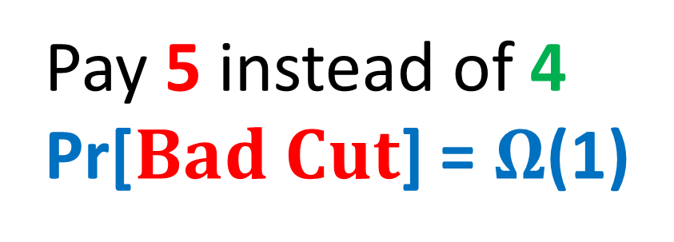
$$Randomly shifted quadtree$$
Top cell shifted by a random vector in ${\left[0,L\right]}^{2}$
Impose a randomly shifted quadtree (top cell length $2Δ$)
Bottom-up: For each cell in the quadtree
  Compute optimum MSTs in subcells
  Use $εL$-net from each cell on the next level
Pay 5 instead of 4
Pr[$Bad Cut$] = $Ω$(1)
2
$$Bad Cut$$
1

Slide 23

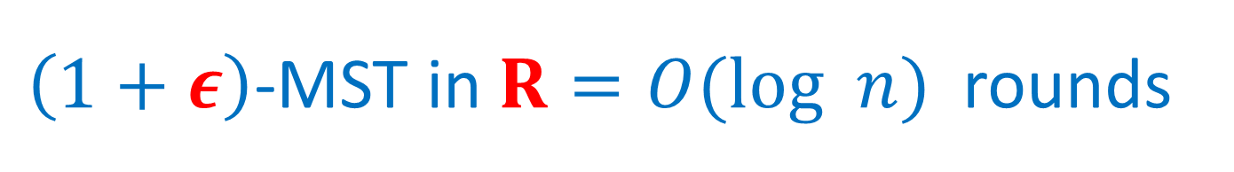
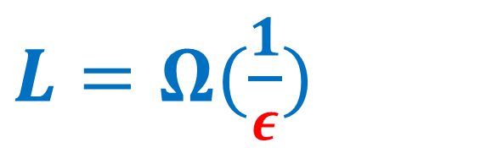
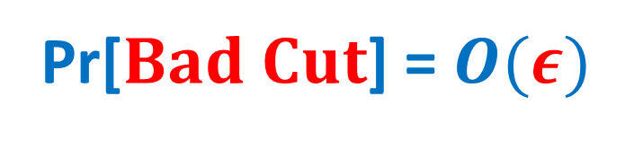
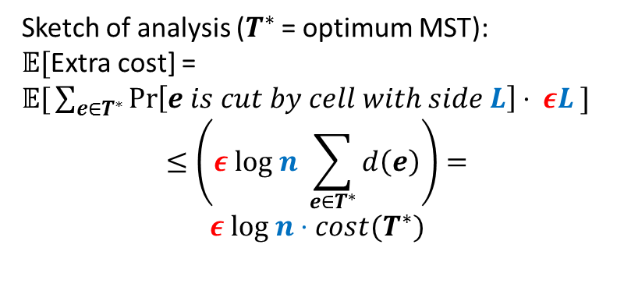
$\left(1+ε\right)$-MST in $R=O(log n)$rounds
Idea: Only use short edges inside the cells
Impose a randomly shifted quadtree (top cell length $\frac{2Δ}{ε }$ )
Bottom-up: For each node (cell) in the quadtree
  compute optimum Minimum Spanning Forests in subcells, using edges of length $≤εL$
  Use only $ε^{2}L$-net from each cell on the next level
Sketch of analysis ($T^{∗}$ = optimum MST):
𝔼[Extra cost] =
𝔼$\text{[}\sum_{e∈T^{∗}}{\operatorname{Pr}\left[e is cut by cell with side L\right]⋅ εL} ]$
$$≤\left(ε log n \sum_{e∈T^{∗}}{d\left(e\right)}\right)=$$
$$ε log n⋅cost(T^{∗})$$
$L=Ω(\frac{1}{ε})$
2
Pr[$Bad Cut$] = $O(ε)$
1

Slide 24

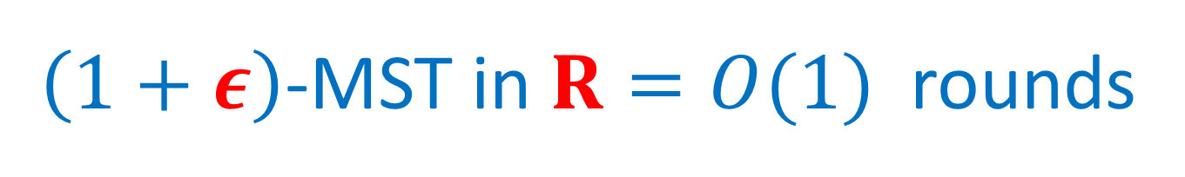


$\left(1+ε\right)$-MST in $R=O(1)$rounds
$O(log n)$ rounds => O($\log_{S}{n}$) = O(1) rounds
  Flatten the tree: ($\sqrt{S}×\sqrt{S}$)-grids instead of (2x2) grids at each level.
Impose a randomly shifted ($\sqrt{S}×\sqrt{S}$)-tree
Bottom-up: For each node (cell) in the tree
  compute optimum MSTs in subcells via edges of length $≤εL$
  Use only $ε^{2}L$-net from each cell on the next level
$$\sqrt{S}=n^{Ω(1)}$$
⇒

Slide 25
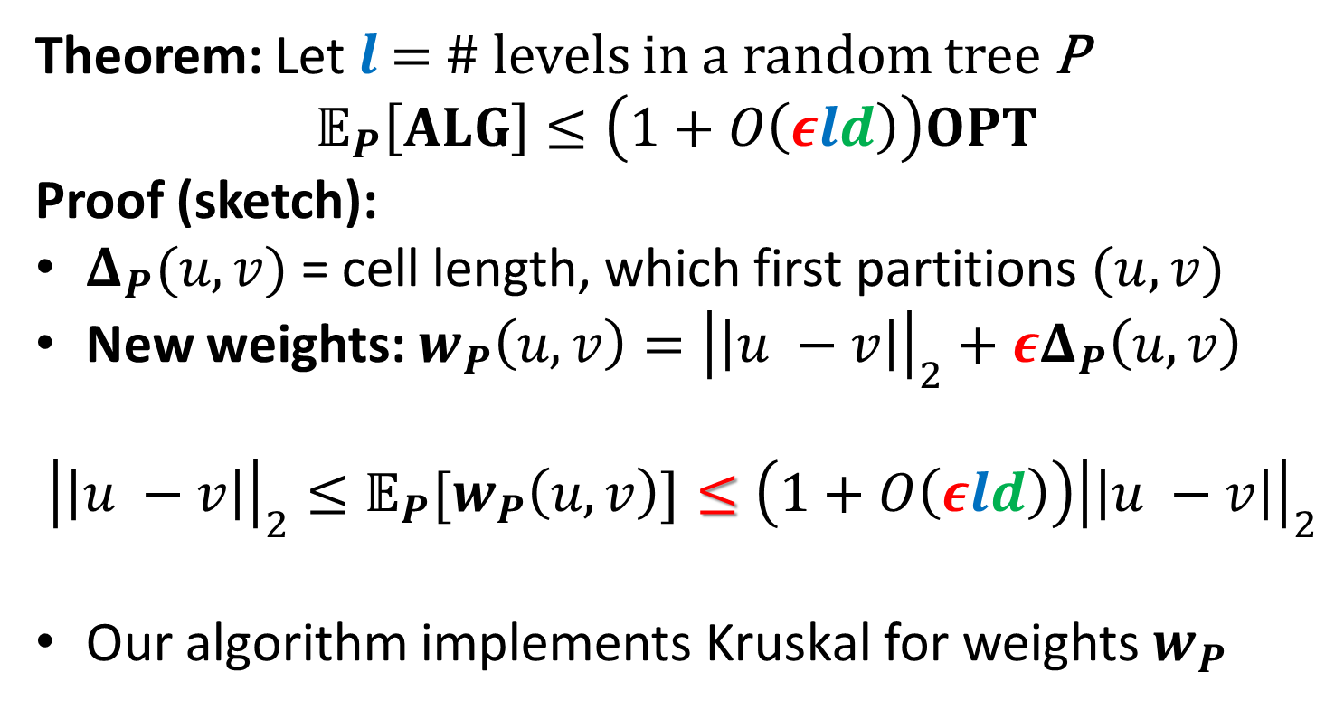



$\left(1+ε\right)$-MST in $R=O(1)$rounds
Theorem: Let $l$ = # levels in a random tree P
$$𝔼_{P}\left[ALG\right]≤\left(1+O\left(εld\right)\right)OPT$$
Proof (sketch):
$Δ_{P}(u,v)$ = cell length, which first partitions $(u, v)$
New weights: $w_{P}\left(u,v\right)={\left|\left|u −v\right|\right|}_{2}+εΔ_{P}\left(u,v\right)$
$${{\left|\left|u −v\right|\right|}_{2}≤𝔼_{P}[w}_{P}\left(u,v\right)]≤\left(1+O\left(εld\right)\right){\left|\left|u −v\right|\right|}_{2}$$
Our algorithm implements Kruskal for weights $w_{P}$
$$u$$
$$v$$
$$Δ_{P}\left(u,v\right)$$

Slide 26
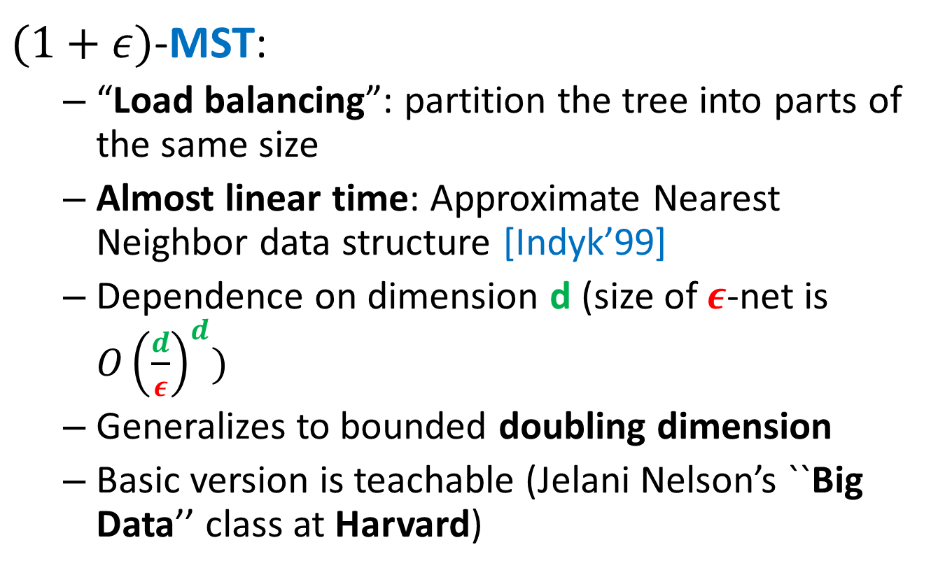
“Solve-And-Sketch” Framework
$(1+ε)$-MST:
  “Load balancing”: partition the tree into parts of the same size
  Almost linear time: Approximate Nearest Neighbor data structure [Indyk’99]
  Dependence on dimension d (size of $ε$-net is ${O\left(\frac{d}{ε}\right)}^{d})$
  Generalizes to bounded doubling dimension
  Basic version is teachable (Jelani Nelson’s ``Big Data’’ class at Harvard)

Slide 27
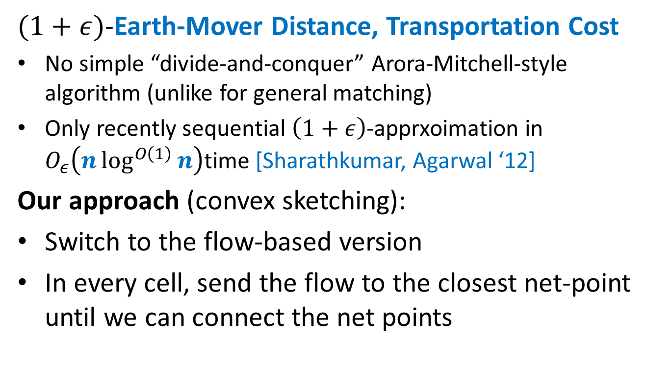
“Solve-And-Sketch” Framework
$(1+ε)$-Earth-Mover Distance, Transportation Cost
No simple “divide-and-conquer” Arora-Mitchell-style algorithm (unlike for general matching)
Only recently sequential $\left(1+ε\right)$-apprxoimation in $O_{ε}\left(n\log^{O\left(1\right)}{n}\right)$time [Sharathkumar, Agarwal ‘12]
Our approach (convex sketching):
Switch to the flow-based version
In every cell, send the flow to the closest net-point until we can connect the net points

Slide 28
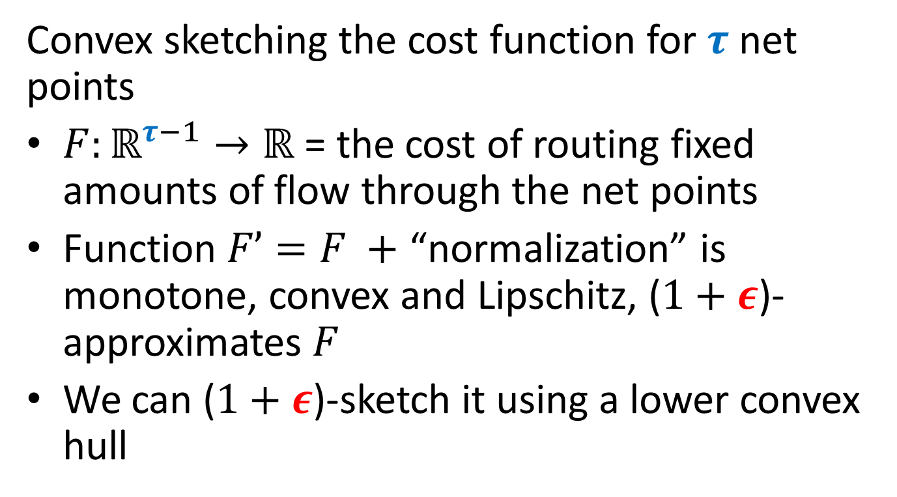
“Solve-And-Sketch” Framework
Convex sketching the cost function for $τ$ net points
$F:ℝ^{τ−1}→ℝ$ = the cost of routing fixed amounts of flow through the net points
Function $F’=F +$ “normalization” is monotone, convex and Lipschitz, ($1+ε$)-approximates $F$
We can ($1+ε$)-sketch it using a lower convex hull

Slide 29
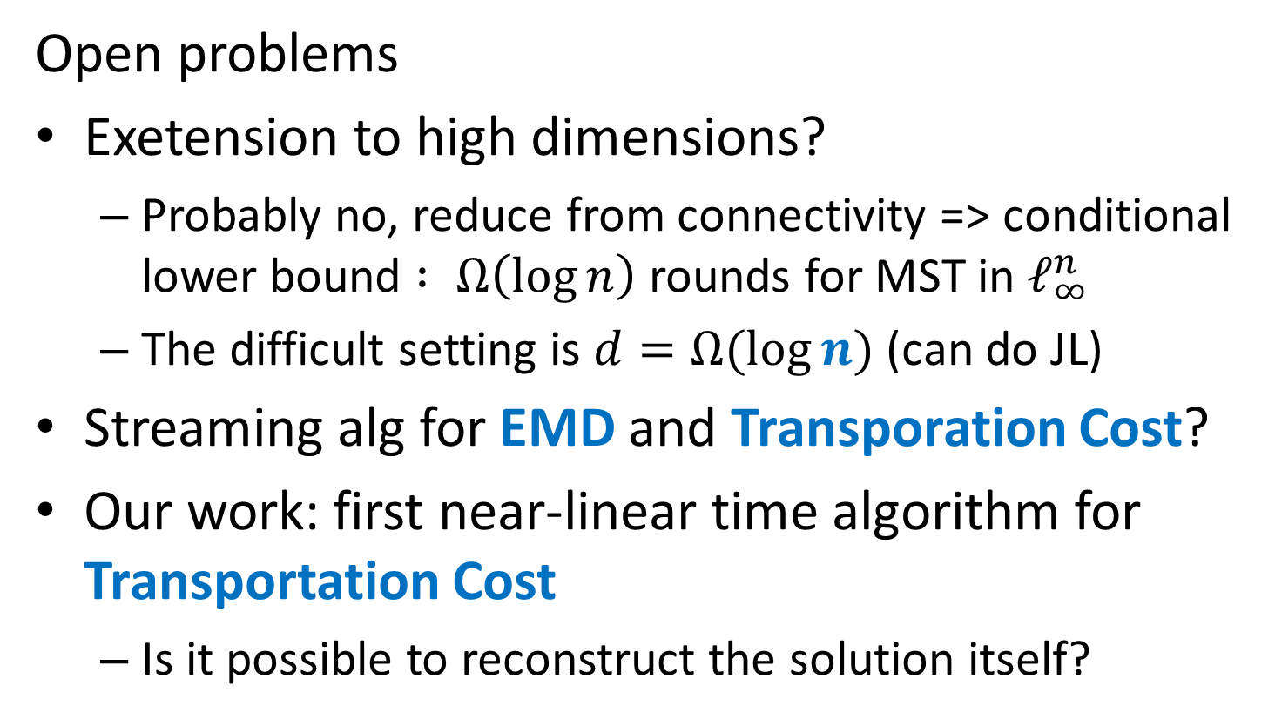
Thank you! http://grigory.us
Open problems
Exetension to high dimensions?
  Probably no, reduce from connectivity => conditional lower bound $: Ω\left(\log{n}\right)$ rounds for MST in $ℓ_{∞}^{n}$
  The difficult setting is $d=Ω(\log{n})$ (can do JL)
Streaming alg for EMD and Transporation Cost?
Our work: first near-linear time algorithm for Transportation Cost
  Is it possible to reconstruct the solution itself?

